Slide 1
Fitting a line

Slide 2
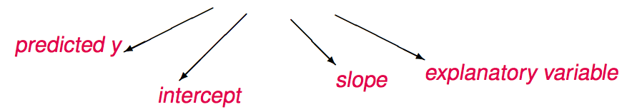

The linear regression line
$$\hat{y}=b_{0}+b_{1}x$$
Notations:
Intercept:
Parameter: β₀
Point estimate: b₀
Slope:
Parameter: β₁
Point estimate: b₁

Slide 3
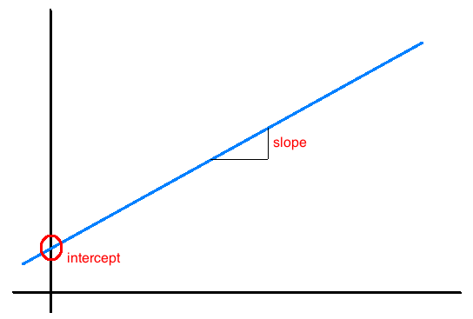
Interpretation of slope and intercept
Intercept: When x = 0, y is expected to equal the intercept.
Slope: For each unit in x, y is expected to increase / decrease on average by the slope.
Note: These statements are not causal, unless the study is a randomized controlled experiment.

Slide 4
Conditions
Linearity
Nearly normal residuals
Constant variability

Slide 5
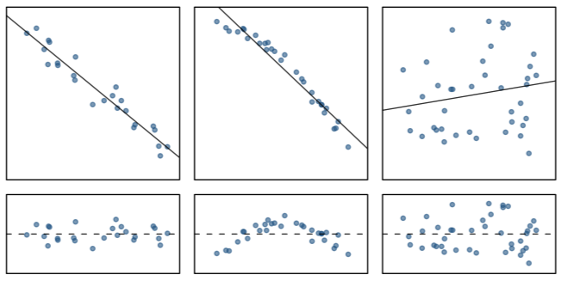
Conditions: (1) Linearity
The relationship between the explanatory and the response variable should be linear.

Slide 6
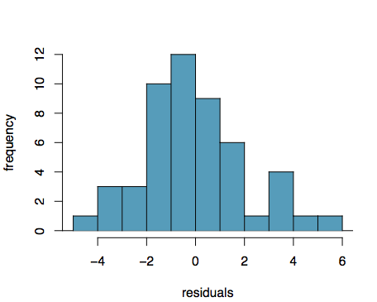
Conditions: (2) Nearly normal residuals
The residuals should be nearly normal.
Check using a histogram or normal probability plot of residuals.

Slide 7
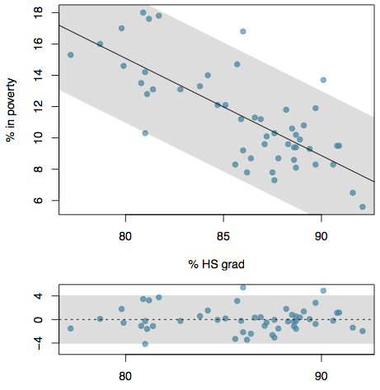
Conditions: (3) Constant variability
The variability of residuals should be roughly constant.
This implies that the variability of residuals around the 0 line should be roughly constant as well.
Check using a plot of residuals.

Slide 8
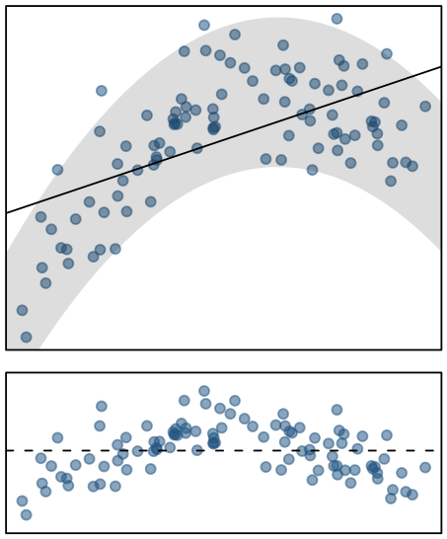
Checking conditions
What condition is this linear model obviously violating?
Constant variability
Linear relationship
Normal residuals
No extreme outliers

Slide 9
Checking conditions
What condition is this linear model obviously violating?
Constant variability
Linear relationship
Normal residuals
No extreme outliers

Slide 10
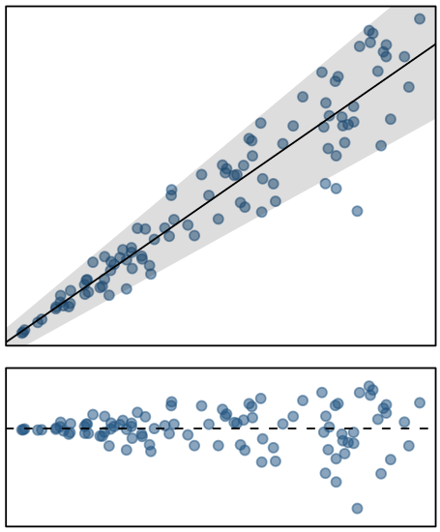
Checking conditions
What condition is this linear model obviously violating?
Constant variability
Linear relationship
Normal residuals
No extreme outliers

Slide 11
Checking conditions
What condition is this linear model obviously violating?
Constant variability
Linear relationship
Normal residuals
No extreme outliers

Slide 12
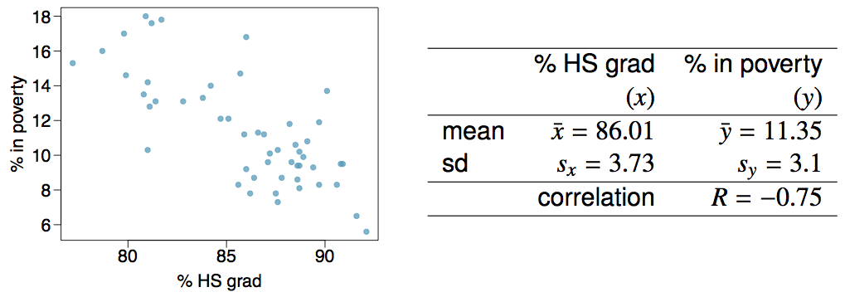
Given...

Slide 13


Slope
The slope of the regression can be calculated as
In context...

Slide 14
Slope
The slope of the regression can be calculated as
In context...
Interpretation
For each additional % point in HS graduate rate, we would expect the % living in poverty to be lower on average by 0.62% points.

Slide 15
Intercept
The intercept is where the regression line intersects the y-axis. The calculation of the intercept uses the fact the a regression line always passes through (x̄, ȳ).
b₀ = ȳ - b₁ x̄

Slide 16
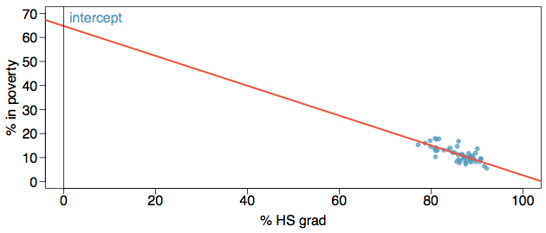
Intercept
The intercept is where the regression line intersects the y-axis. The calculation of the intercept uses the fact the a regression line always passes through (x̄, ȳ).
b₀ = ȳ - b₁ x̄
b₀ = 11.35 - (-0.62) x 86.01
= 64.68

Slide 17
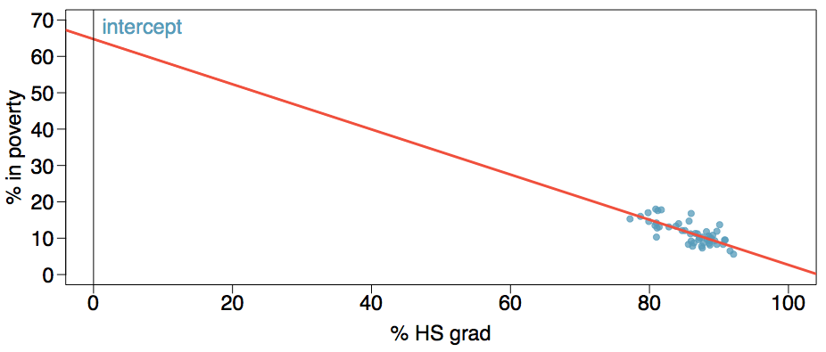
More on the intercept
Since there are no states in the dataset with no HS graduates, the intercept is of no interest.

Slide 18
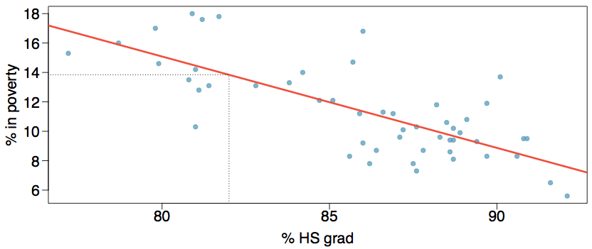
Prediction
Using the linear model to predict the value of the response variable for a given value of the explanatory variable is called prediction, simply by plugging in the value of x in the linear model equation.
There will be some uncertainty associated with the predicted value.

Slide 19
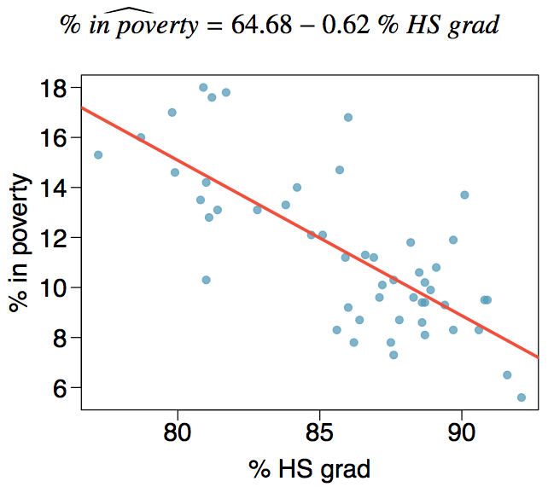
Regression line

